Slide 1

Project X-Alpha: Climate & Environmental Monitoring
Welcome to Project X-Alpha's hackathon submission. Our innovative web application offers comprehensive climate and environmental monitoring, powered by advanced AI and designed for an intuitive user experience. We are focused on delivering crucial real-time data for the local area of Biratnagar.

Slide 2




Team Leader
Team Members
Satyam Gupta
Ajit Mahato
Suraj Kumar Mahara
Md Farhan Ajad
Harisankar Yadav
Team Name
X-Alpha

Slide 3
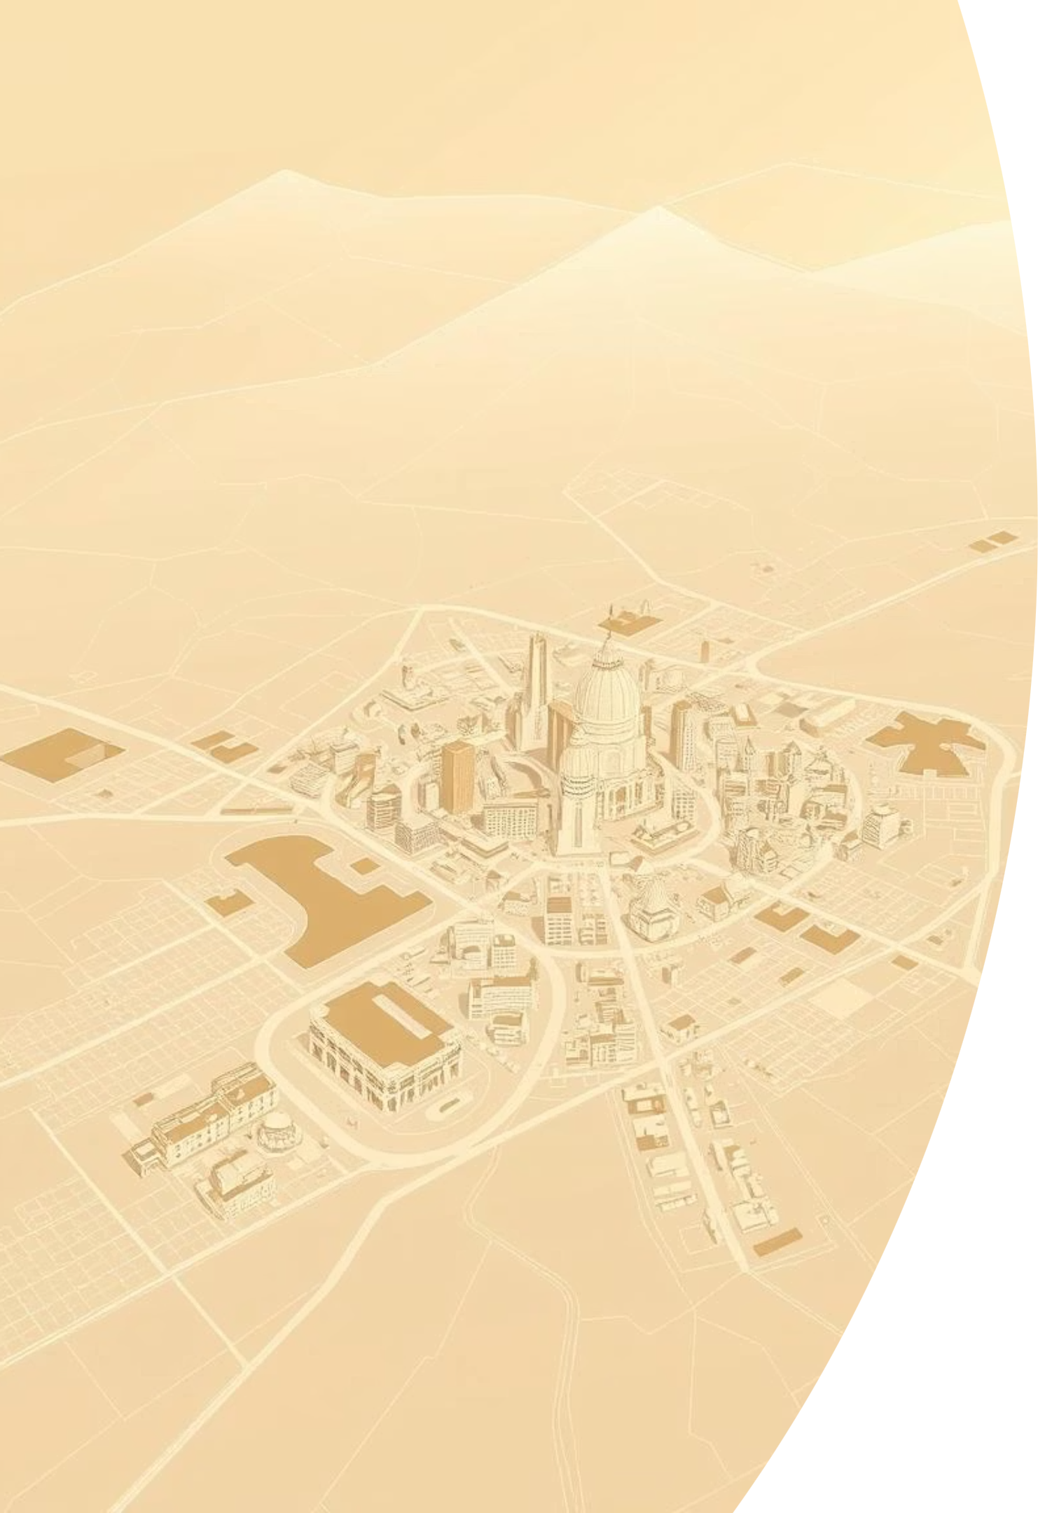

Addressing Critical Environmental Needs
Our project's core theme revolves around critical climate and environmental monitoring. We've developed a robust web application to address the growing need for accessible, real-time environmental data, starting with the Biratnagar region.
Focused on hyperlocal data to empower communities.

Slide 4
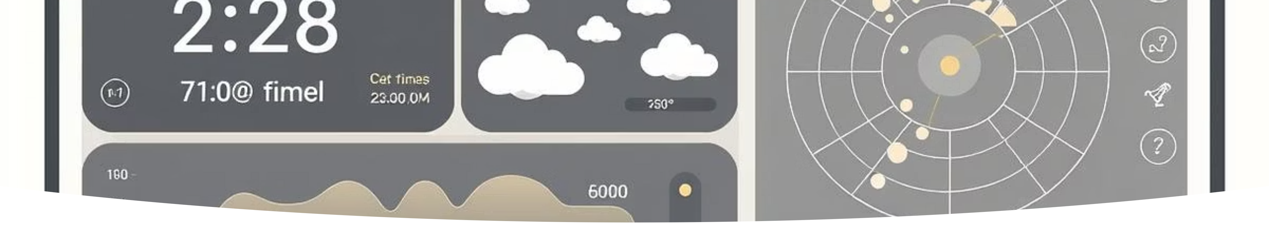
Real-time Data at Your Fingertips
The X-Alpha platform provides a wealth of real-time environmental metrics for the local area of Biratnagar, ensuring users have the most current information available.
Weather Detection
Temperature Tracking
Air Pressure Measurement
Humidity Levels

Slide 5

Beyond Basic Metrics: Comprehensive Monitoring
Our monitoring capabilities extend beyond standard weather, providing a holistic view of the local environment. This detailed data empowers users with a deeper understanding of their surroundings.
Wind Speed and Direction
Visibility Index
UV Index Monitoring
These advanced metrics contribute to a more complete environmental picture, crucial for various applications, from agricultural planning to public health advisories.

Slide 6


The Power of Custom AI Integration
At the heart of Project X-Alpha is our bespoke AI system. Fully functional and seamlessly integrated, our AI transforms raw data into actionable insights, enhancing the user experience significantly.
Our AI is designed to assist users with intelligent weather insights, personalised recommendations, and intuitive platform navigation.

Slide 7
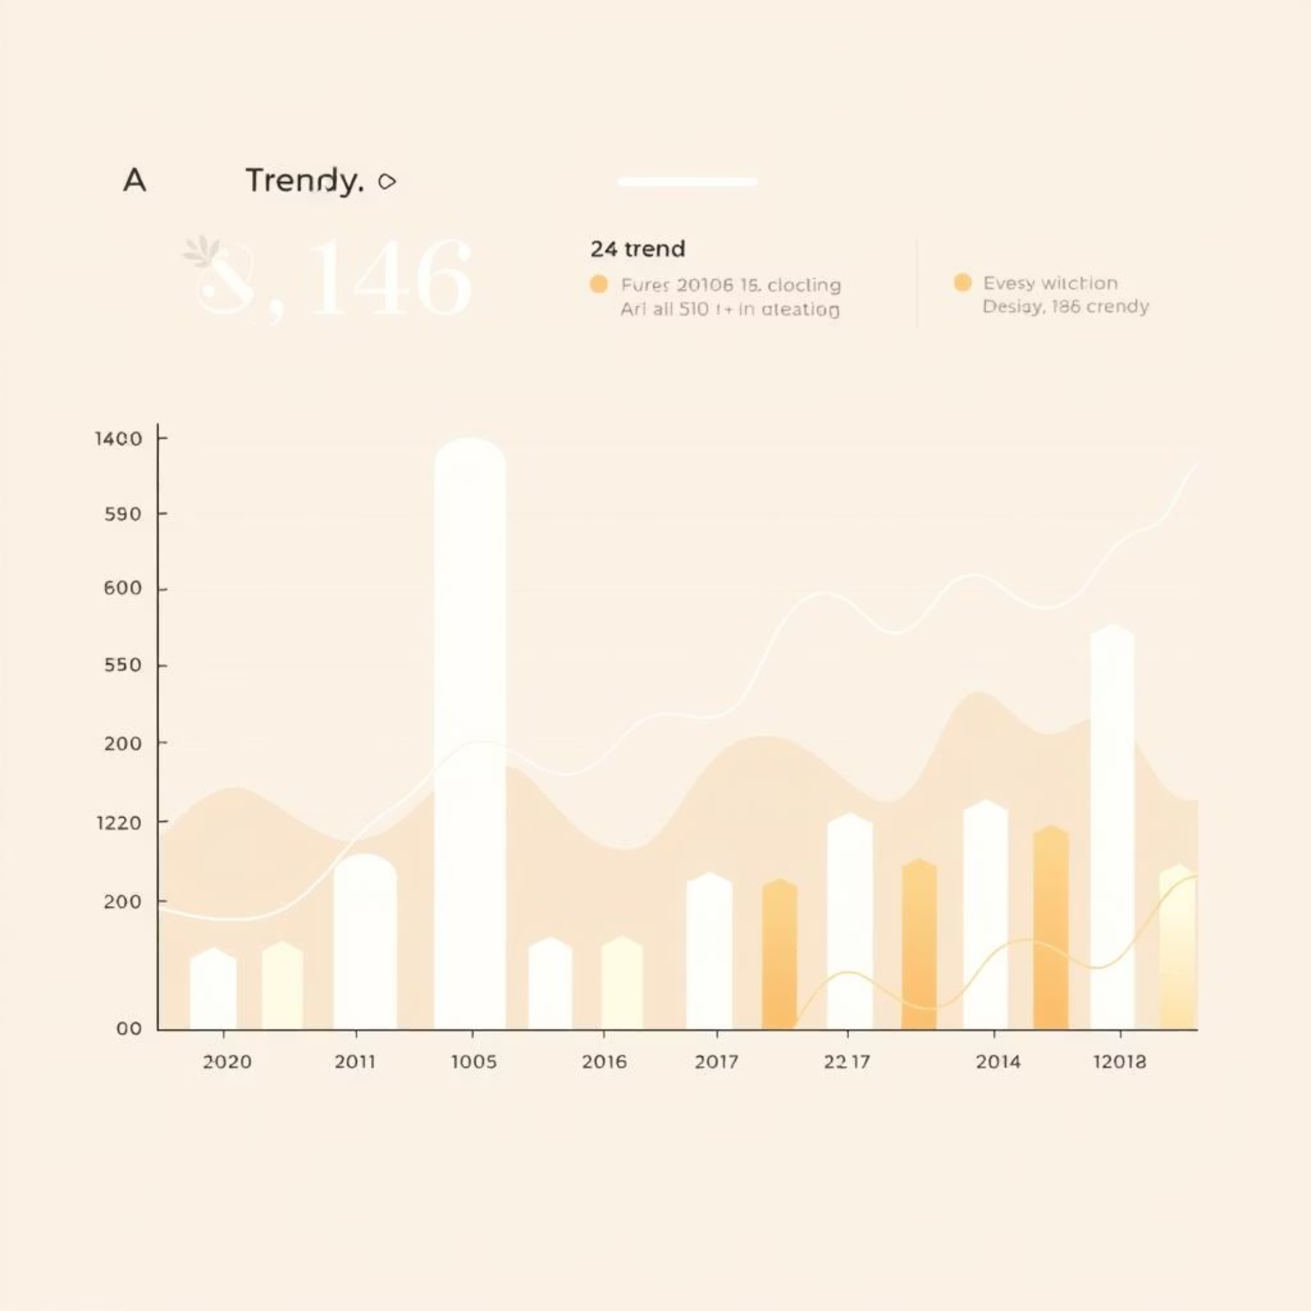
AI Capabilities: Insights & Recommendations
Intelligent Weather Insights
The AI analyses complex environmental data patterns to provide accurate and easy-to-understand weather forecasts and trend analyses, helping users anticipate changes.
Personalised Recommendations
Based on current conditions and user profiles, the AI offers tailored suggestions, from optimal outdoor activity times to necessary precautions for adverse weather.

Slide 8
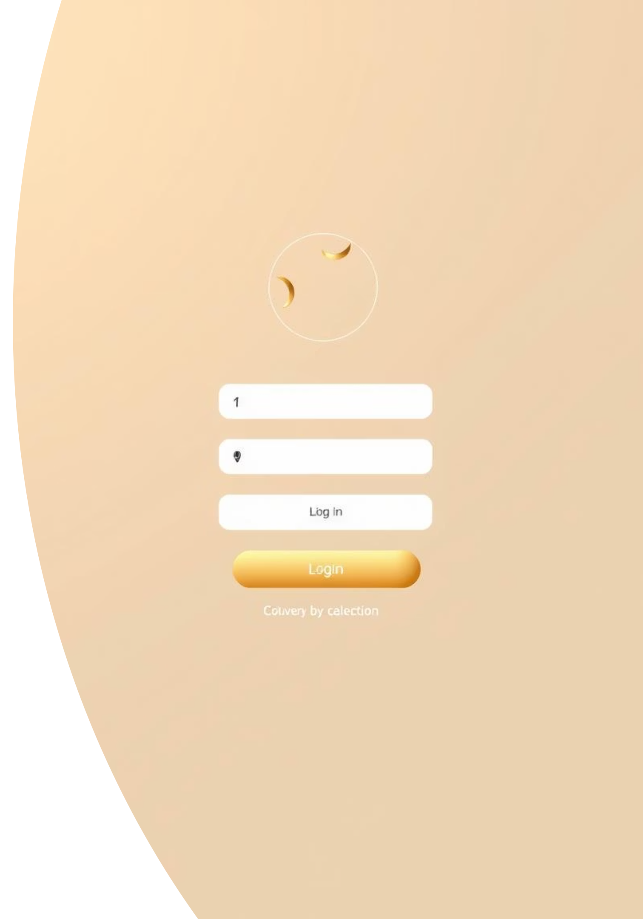
Intuitive User Interface & Account System
We believe in a user-first approach. Our platform features a meticulously designed login and signup interface, ensuring a smooth and secure onboarding process for every user.
Clean & User-Friendly
A minimalist design ensures easy navigation and a pleasant visual experience.
Secure Authentication
Robust login and signup protocols protect user data and privacy.

Slide 9
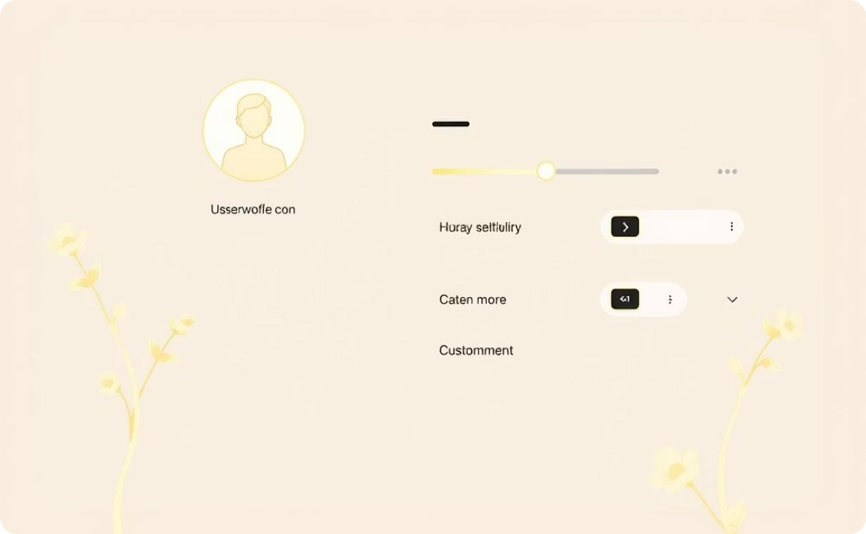
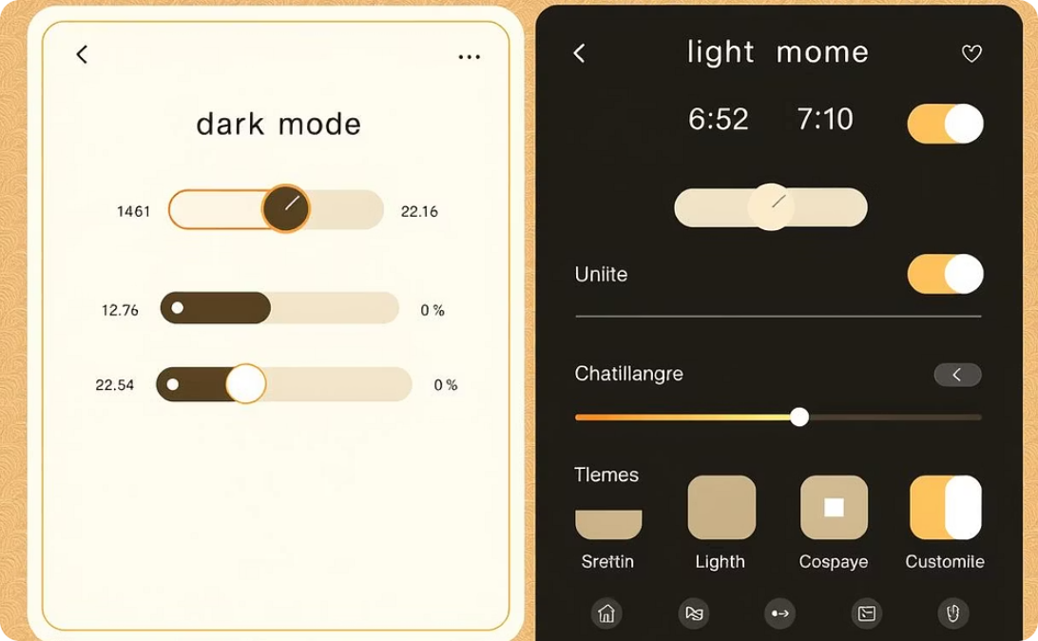
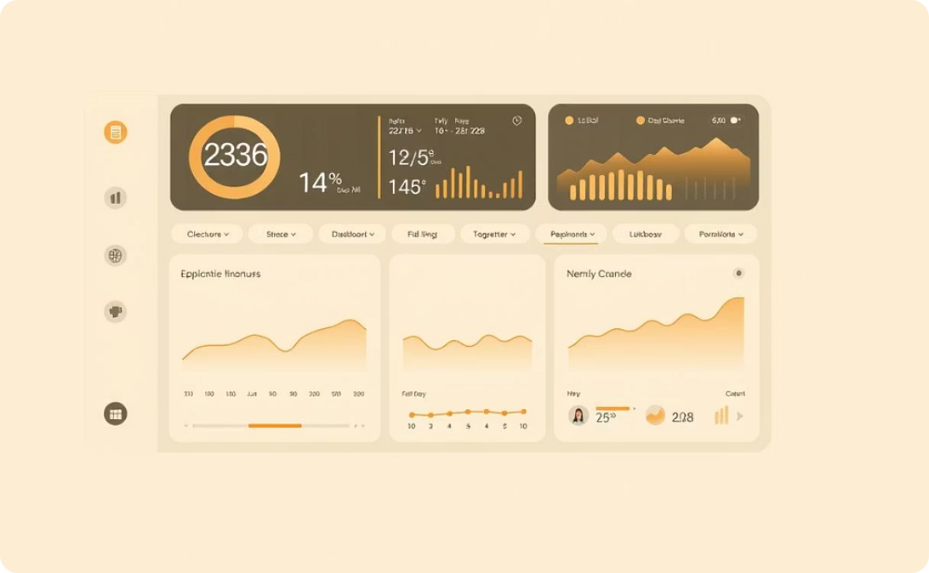
Personalised Profile Management
Every user benefits from a dedicated profile manager, offering extensive customisation options to tailor the platform to their individual preferences and needs.
Adjustable Settings
Theme Customisation
Enhanced User Experience
Control notifications, data display, and privacy settings with ease.
Switch between light and dark modes, or choose from various colour schemes for a truly personal look and feel.
A customised environment improves engagement and makes data consumption more enjoyable and efficient.

Slide 10

Project X-Alpha: Our Vision for a Greener Future
Project X-Alpha represents more than just a web application; it's a step towards more informed and environmentally conscious communities. Our platform, with its real-time data, AI insights, and user-centric design, offers a powerful tool for environmental stewardship.
We are committed to continuous development, expanding our monitoring capabilities and AI intelligence to serve a wider audience and contribute to global climate awareness.

